Slide 1
Towards a general data model of waste flows
Jonathan Cohen, PhD student
Jorge Gil, Supervisor
Lars Marcus, Supervisor

Slide 2
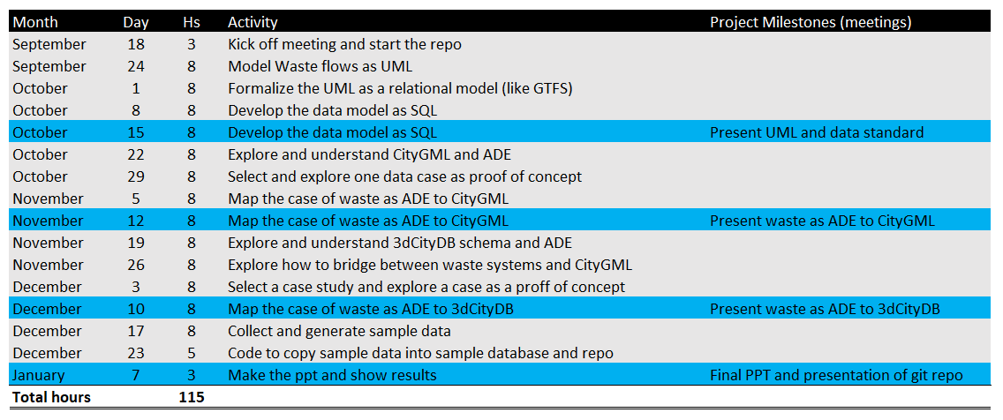
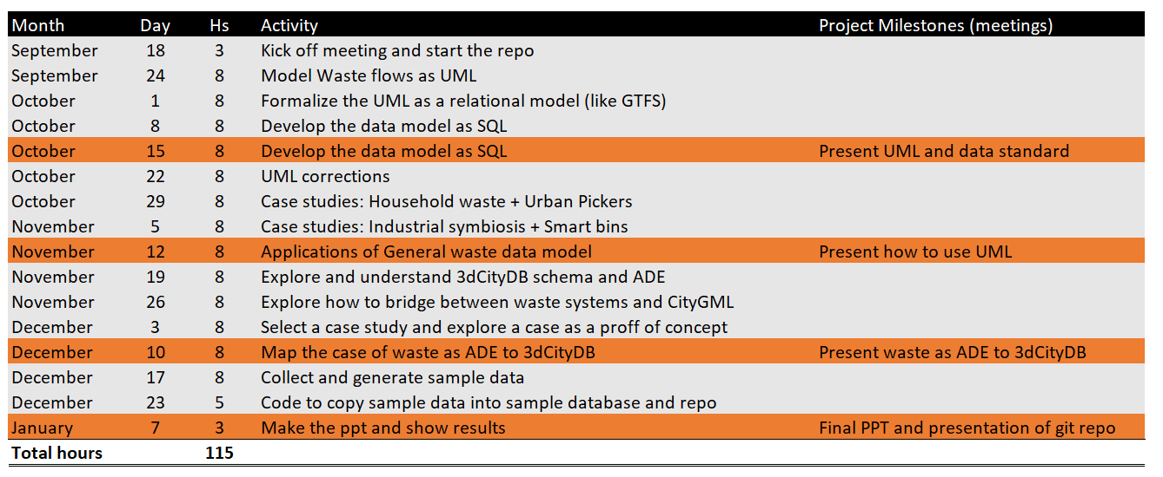
Time plan

Slide 3
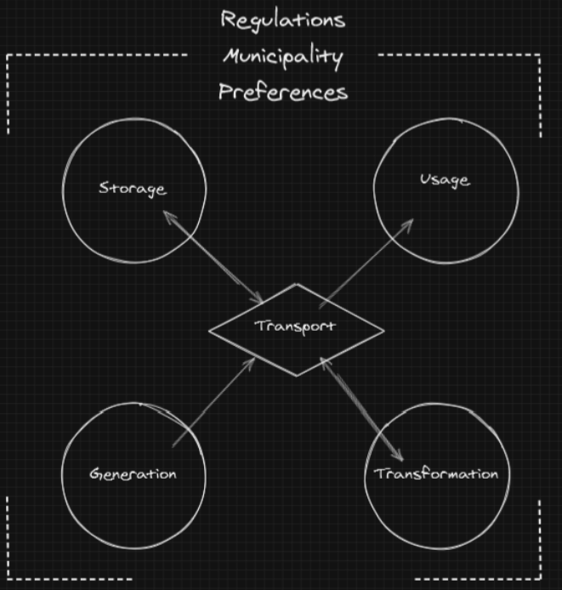
Conceptual model of waste flows I
Any socio-economic activity happening within an urban/regional system need, use and interact with a set of support systems.
Physical support systems such as the road and electricity network
Institutional support system as the set of laws and regulations that determine how a system should behave
Socio-cultural support system that determine how the citizens interact with the system
Resources (and secondary ones) can be
Created
Used
Transformed
Stored
In most of cases after one of these actions is executed the resources, goods or waste materials are moved from one place to another
Notes:
To add name and research group or other organisational affiliation, go to View > Slide master. Add name and affiliation in third slide (after the dark blue introduction slide). This will then be visible on all slides (except for template slide number 11, which consists of a collage of six images)

Slide 4
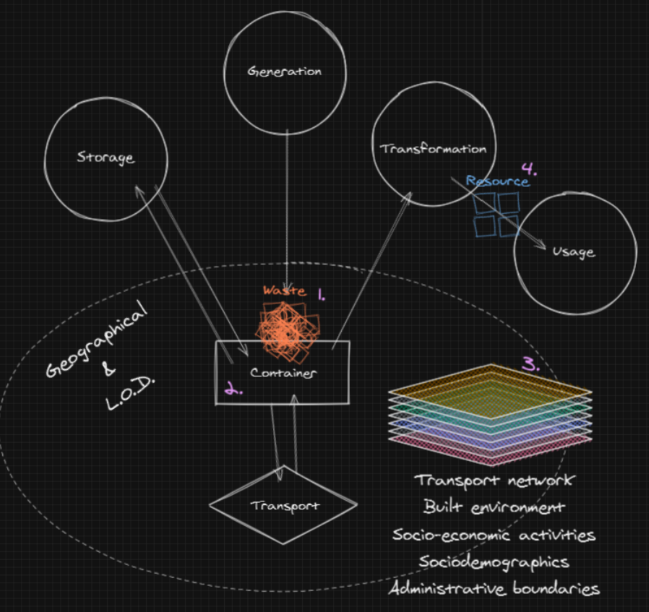
Conceptual model of waste flows II
Generation: Every time there is a process, a by-product is generated. Waste means any substance or object which the holder discards or intends or is required to discard. It has no value. It cannot purchase or sold.
Transformation: By various means any waste or part of it can be transformed into a resource that can be re-introduced in the market for its use.
Storage: When ever waste materials are stored over time.
Usage: After upgrading a by-product, it could be used by another or the same industry.
Transport: Every time a waste material is moved from one container to another, there is need for transportation
Containers: Is the physical object or place that contains the waste
Support systems: Are the geographical and socio-economic systems that allow and determine activities in the territory
Notes:
To add name and research group or other organisational affiliation, go to View > Slide master. Add name and affiliation in third slide (after the dark blue introduction slide). This will then be visible on all slides (except for template slide number 11, which consists of a collage of six images)

Slide 5
Applications of the data model to real cases

Slide 6
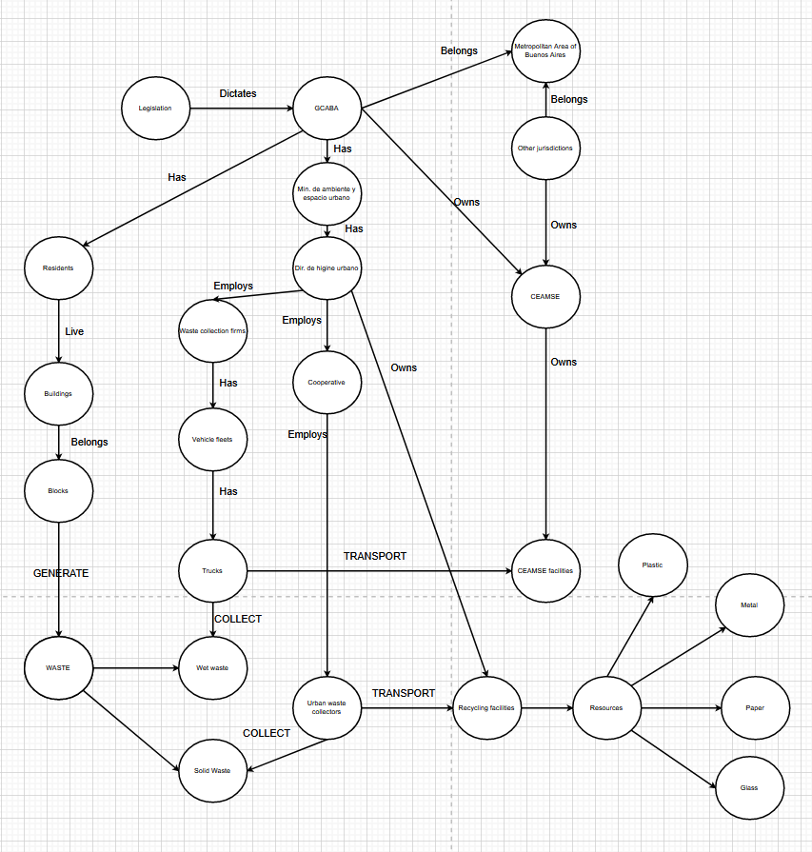
Case I: Urban pickers in CABA

Slide 7
Case I: Urban pickers in CABA

Slide 8
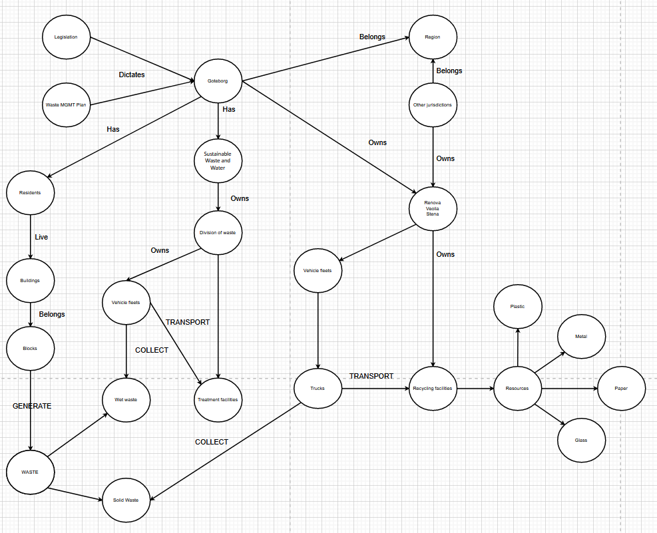
Case II: Solid waste MGMT in GBG

Slide 10
October 15th
Jonathan Cohen, PhD student
Jorge Gil, Supervisor
Lars Marcus, Supervisor

Slide 11
Time plan

Slide 12
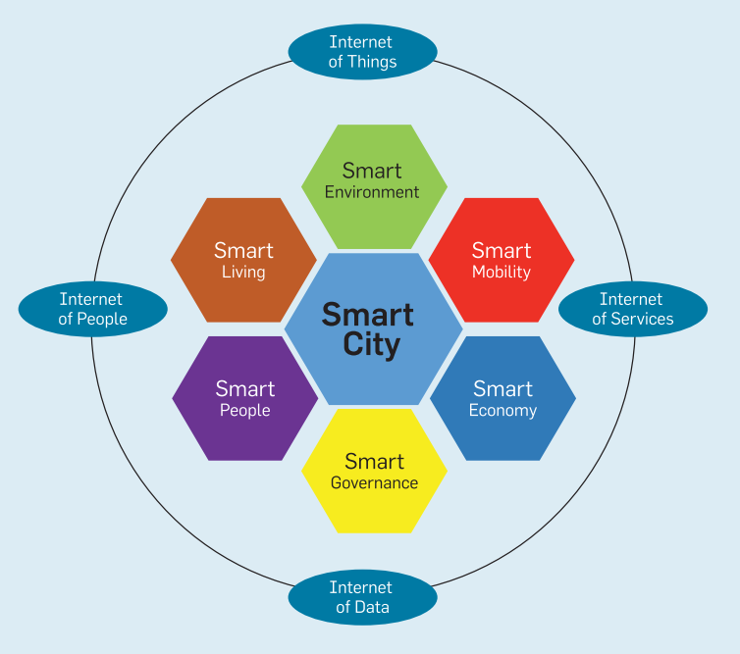
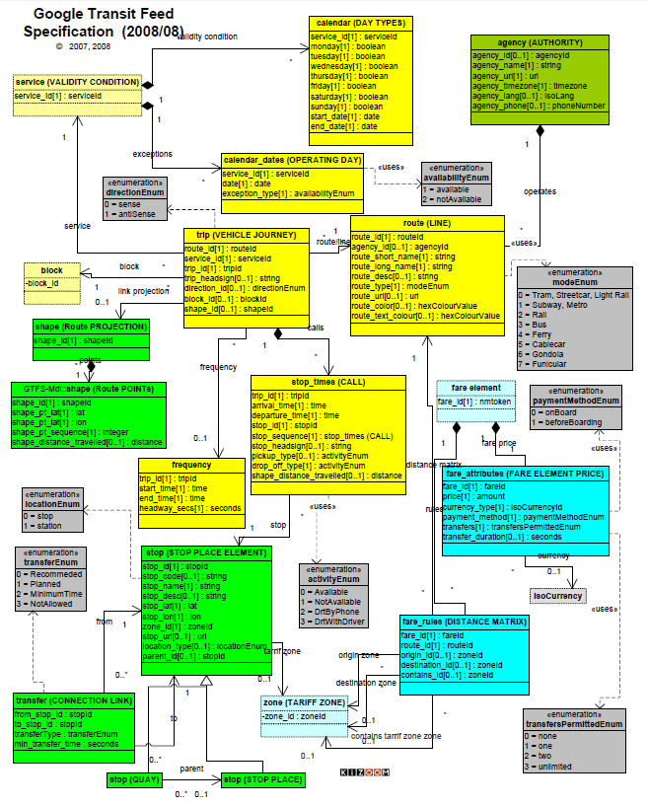
Motivation and vision
Notes:
To add name and research group or other organisational affiliation, go to View > Slide master. Add name and affiliation in third slide (after the dark blue introduction slide). This will then be visible on all slides (except for template slide number 11, which consists of a collage of six images)

Slide 13
Conceptual model of waste flows I
Any socio-economic activity happening within an urban/regional system need, use and interact with a set of support systems.
Physical support systems such as the road and electricity network
Institutional support system as the set of laws and regulations that determine how a system should behave
Socio-cultural support system that determine how the citizens interact with the system
Resources (and secondary ones) can be
Created
Used
Transformed
Stored
In most of cases after one of these actions is executed the resources, goods or waste materials are moved from one place to another
Notes:
To add name and research group or other organisational affiliation, go to View > Slide master. Add name and affiliation in third slide (after the dark blue introduction slide). This will then be visible on all slides (except for template slide number 11, which consists of a collage of six images)

Slide 14
Conceptual model of waste flows II
Generation: Every time there is a process, a by-product is generated. Waste means any substance or object which the holder discards or intends or is required to discard. It has no value. It cannot purchase or sold.
Transformation: By various means any waste or part of it can be transformed into a resource that can be re-introduced in the market for its use.
Storage: When ever waste materials are stored over time.
Usage: After upgrading a by-product, it could be used by another or the same industry.
Transport: Every time a waste material is moved from one container to another, there is need for transportation
Containers: Is the physical object or place that contains the waste
Support systems: Are the geographical and socio-economic systems that allow and determine activities in the territory
Notes:
To add name and research group or other organisational affiliation, go to View > Slide master. Add name and affiliation in third slide (after the dark blue introduction slide). This will then be visible on all slides (except for template slide number 11, which consists of a collage of six images)

Slide 15
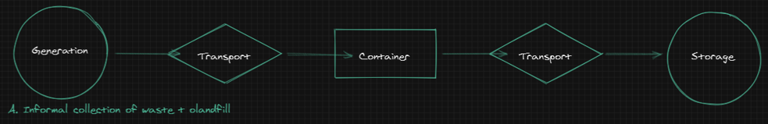
Instances of the model - A
Commercial office
Transfer station
Landfill
Informal collector
SWM collection service
Paper waste
Paper waste
Paper waste
Notes:
To add name and research group or other organisational affiliation, go to View > Slide master. Add name and affiliation in third slide (after the dark blue introduction slide). This will then be visible on all slides (except for template slide number 11, which consists of a collage of six images)

Slide 16
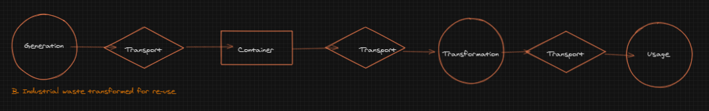
Instances of the model - B
Apple packhouse
Material warehouse
Cleaning process
Furniture production
SWM collection service
SWM collection service
SWM collection service
Wood pallets
Wood pallets
Wood
Furniture
Notes:
To add name and research group or other organisational affiliation, go to View > Slide master. Add name and affiliation in third slide (after the dark blue introduction slide). This will then be visible on all slides (except for template slide number 11, which consists of a collage of six images)

Slide 17
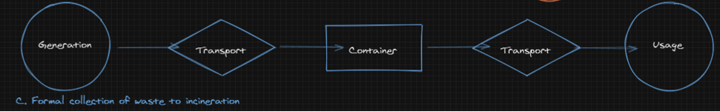
Instances of the model - C
Households
Transfer station
Incineration
SWM collection service
SWM collection service
Food Waste
Food waste
Food Waste
Notes:
To add name and research group or other organisational affiliation, go to View > Slide master. Add name and affiliation in third slide (after the dark blue introduction slide). This will then be visible on all slides (except for template slide number 11, which consists of a collage of six images)

Slide 18
UML / ERM
Notes:
To add name and research group or other organisational affiliation, go to View > Slide master. Add name and affiliation in third slide (after the dark blue introduction slide). This will then be visible on all slides (except for template slide number 11, which consists of a collage of six images)

Slide 19
Logotype

